Slide 2
1. Role of File Systems
Primary Responsibilities:
  Organize, store, retrieve, name, share, and protect files.
  Provide a programming interface to abstract file storage details (e.g., storage allocation and layout).
File Structure:
  Data: A sequence of data items (e.g., 8-bit bytes) accessible via read/write operations.
  Attributes: Metadata such as file length, timestamps, file type, owner identity, and access control lists (ACLs).
Directories:
  Special files that map text names to internal file identifiers.
  Support hierarchical naming schemes (e.g., UNIX pathnames).

Slide 3
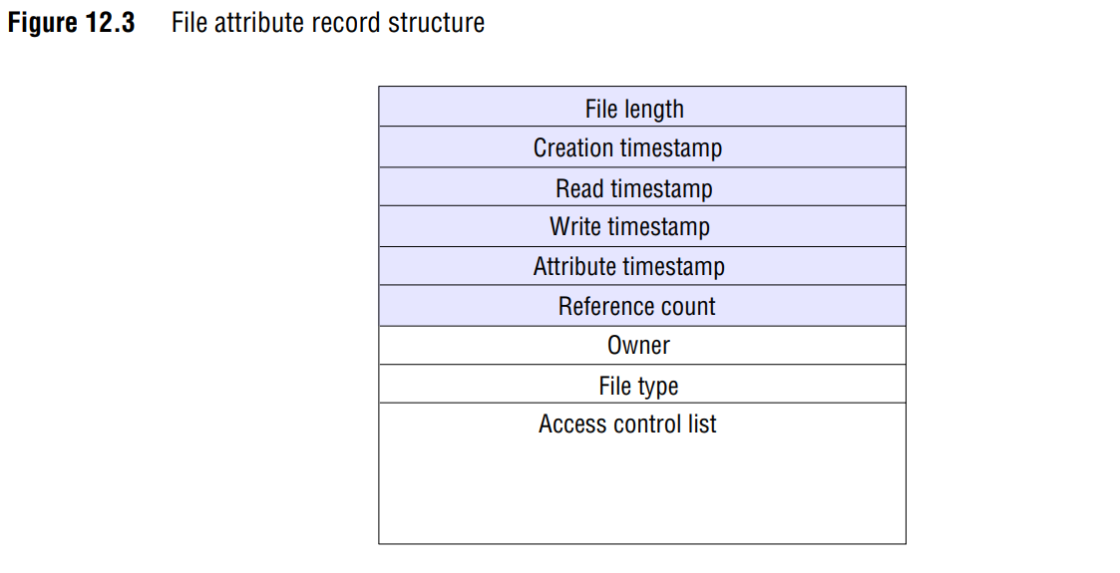

Slide 4
2. File System Operations
Core Operations (e.g., UNIX):
  open(name, mode): Opens an existing file.
  creat(name, mode): Creates a new file.
  close(filedes): Closes an open file.
  read(filedes, buffer, n): Reads n bytes from a file.

Slide 5
2. File System Operations
Core Operations (e.g., UNIX):
  write(filedes, buffer, n): Writes n bytes to a file.
  lseek(filedes, offset, whence): Moves the read/write pointer.
  unlink(name): Removes a file name (deletes the file if no other names exist).
  link(name1, name2): Adds a new name for a file.
  stat(name, buffer): Retrieves file attributes.
Access Control:
  File systems enforce access control when files are opened, checking user permissions against requested modes (e.g., read, write).

Slide 6
3. Distributed File Systems
Key Requirements:
  Transparency:
    Access Transparency: Clients access remote files as if they were local.
    Location Transparency: Uniform file namespace; files can be relocated without changing pathnames.
    Mobility Transparency: Files can be moved without changing client programs or configurations.
    Performance Transparency: Consistent performance under varying loads.
    Scaling Transparency: Ability to scale to handle larger loads and network sizes.

Slide 7
3. Distributed File Systems
Key Requirements:
  Concurrency Control: Ensures that simultaneous file updates by multiple clients do not interfere.
  File Replication: Enhances scalability and fault tolerance by maintaining multiple copies of files.
  Heterogeneity: Supports different hardware and operating systems.
  Fault Tolerance: Continues operation despite client or server failures.

Slide 8
3. Distributed File Systems
Key Requirements:
  Consistency: Ensures one-copy update semantics (all clients see the same file state).
  Security: Authenticates clients and protects data with access control, digital signatures, and encryption.
  Efficiency: Matches or exceeds the performance and reliability of local file systems.

Slide 9
4. Challenges in Distributed File Systems
Consistency vs. Performance:
  Strict consistency is difficult to achieve in distributed systems due to replication and caching delays.
  Systems like NFS and AFS use mechanisms to approximate consistency.

Slide 10
4. Challenges in Distributed File Systems
Caching:
  Used to optimize performance but introduces challenges in maintaining consistency.
  Web caching relies on explicit user actions to update cached copies.
Replication:
  Improves fault tolerance and scalability but complicates consistency and access control.

Slide 11
5. Case Studies: NFS and AFS
Sun NFS (Network File System):
  Design Goals: Transparent access to remote files, hardware/OS heterogeneity, and high performance.
  Symmetrical Client-Server Model: Any machine can act as both client and server.
  Wide Adoption: Supported on many platforms (UNIX, Windows, Linux, Mac OS).
  Stateless Design: Simplifies fault tolerance and recovery.

Slide 12
5. Case Studies: NFS and AFS
Andrew File System (AFS):
  Design Goals: Minimize client-server communication by transferring and caching whole files.
  Scalability: Optimized for large-scale information sharing.
  Caching Mechanism: Files are cached at clients until the server provides an updated version.
  Influence: Basis for DCE/DFS in the Open Software Foundation’s Distributed Computing Environment (DCE).

Slide 13
6. Abstract File Service Architecture
Modular Design:
  Client Module: Emulates a conventional file system interface for applications.
  Server Module: Performs directory and file operations for clients.
  Stateless Implementation: Simplifies server design and improves fault tolerance.

Slide 14
7. Evolution of Distributed File Systems
Early Systems: Focused on access and location transparency.
Advanced Systems: Address performance, scalability, concurrency, fault tolerance, and security.
Examples:
  Coda: Supports replication for reliability and disconnected operation.
  Bayou: Provides weakly consistent replication for high availability.
  Google File System (GFS): Designed for large-scale, data-intensive applications like Internet search.

Slide 15
8. Key Takeaways
File Systems: Provide essential abstractions for file storage, naming, sharing, and protection.
Distributed File Systems: Extend these capabilities to networked environments, addressing challenges like transparency, consistency, and fault tolerance.
NFS and AFS: Represent two major approaches to distributed file systems, with NFS focusing on transparency and heterogeneity, and AFS emphasizing scalability and caching.
Future Directions: Advanced systems like Coda, Bayou, and GFS address specific needs such as replication, high availability, and large-scale data management.

